Slide 1
Adapter Pattern
Adapter pattern is a structural pattern
Adapter pattern is often referred to as a bridge between two incompatible classes
This design pattern change one interface for a class into another compatible interface

Slide 2
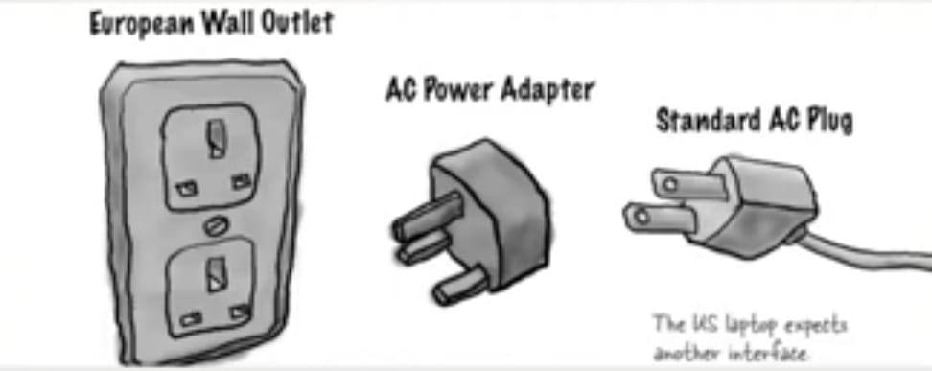
Adapter in Real Life

Slide 3
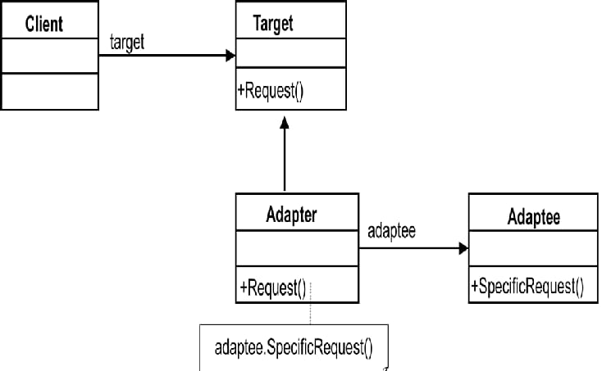
Adapter Pattern : UML Diagram

Slide 4
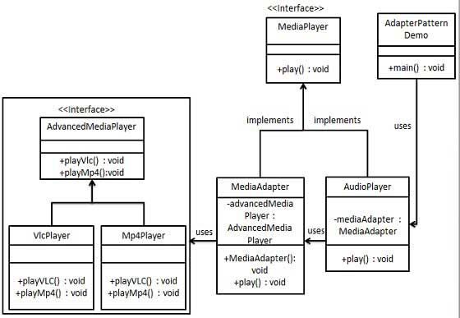
Example

Slide 5
Advantage
Helps achieve reusability and flexibility.
Client class is not complicated by having to use a different interface and can use polymorphism to swap between different implementations of adapters.

Slide 6
Disadvantage
All requests are forwarded, so there is a slight increase in the overhead.
Sometimes many adaptations are required along an adapter chain to reach the type which is required.

